Slide 1
Dart Programming
Module 1

Slide 2
Introduction to Dart Programming Language
Coding style and naming convention, Declaring variables, Numbers, Booleans, const and final keywords Dart Types, Dart operators, Control flow and functions, Understanding classes and constructors, Data structures

Slide 3
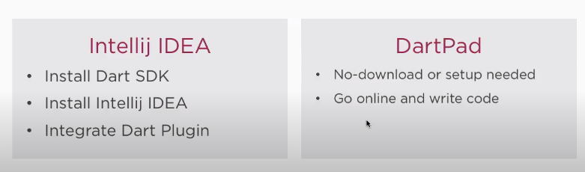
Installation

Slide 4
What is Dart
Developed by Google
Object oriented language
Runs on multiple environment

Slide 5
In Visual Code
Dart extension – dart
Create file save as filename.dart
Run file – In Terminal
- path to file >dart filename.dart

Slide 6
Fundamentals
Static-type
Compiled - Ahead-of-Time (AOT) and Just-In-Time(JIT)
Print and read
Comments - Inline, block, Documentation
Notes:
A JIT compiler converts program source code into native machine code just before program execution.
The Dart VM has a just-in-time compiler (JIT) that supports both pure interpretation (as required on iOS devices, for example) and runtime optimization. This is necessary for a fast development cycle, readily switching between writing the codes and testing on devices on the fly.
The AOT compiler works by compiling your code before it is “delivered” to whatever runtime environment runs the code. The AOT compiler is typically used when the app is ready to be deployed to either an appstore or an in-house production backend.
The AOT-compiled code runs inside an efficient Dart runtime that enforces the sound Dart type system and manages memory using fast object allocation and a generational garbage collector as specified on the dart documentation website.

Slide 7
Comments
// This is a normal, one-line comment.
/// This is a documentation comment, used to document libraries,
/// classes, and their members. Tools like IDEs and dartdoc treat
/// doc comments specially.
/* Comments like these are also supported. */

Slide 8
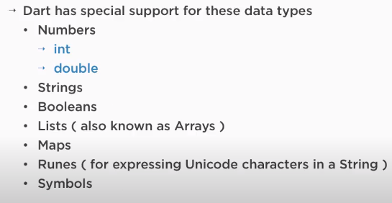
Data Types
EVERYTHING IN DART IS AN OBJECT
Values are by default null

Slide 9
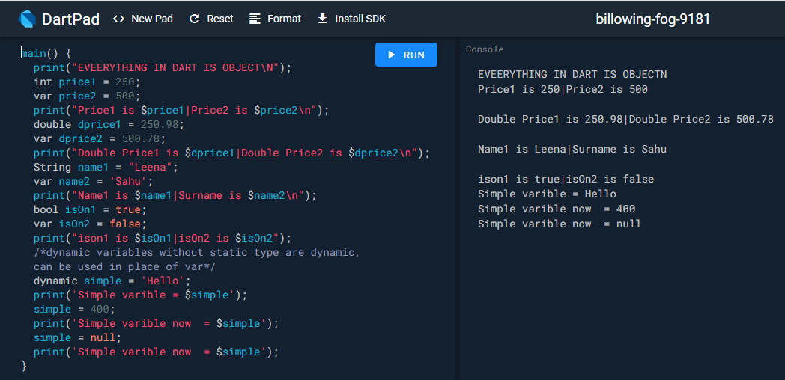

Slide 10
Variables
Even in type-safe Dart code, most variables don’t need explicit types, due to type inference
var name = 'Voyager I'; or String name= 'Voyager I‘;
var year = 1977; or int year=1977;
var antennaDiameter = 3.7;
var flybyObjects = ['Jupiter', 'Saturn', 'Uranus', 'Neptune'];
var image = { 'tags': ['saturn'],
'url': 'https://upload.wikimedia.org/wikipedia/commons/1/17/Google-flutter-logo.png' };

Slide 11
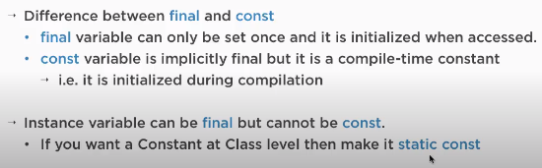
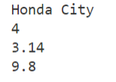
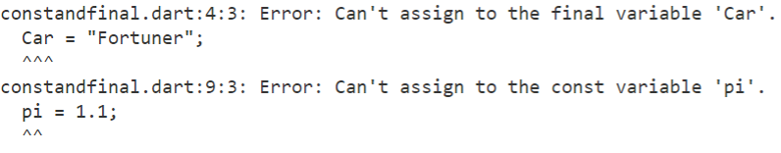
Defining Constants and final
main() {
final Car = "Honda City";
final wheels = 4;
// Car = "Fortuner";
print(Car);
print(wheels);
const pi = 3.14;
const gravity = 9.8;
//pi = 1.1;
print(pi);
print(gravity);
}

Slide 12
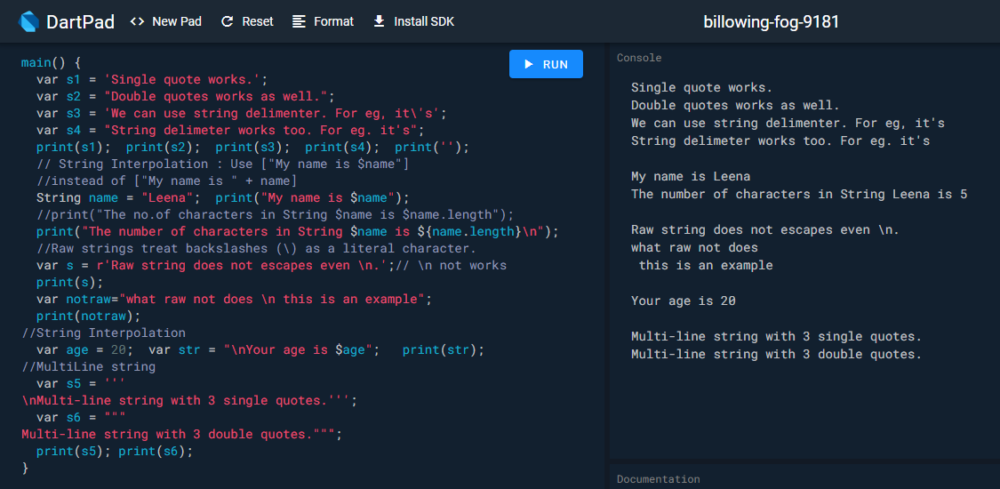
String Interpolation

Slide 13
Control flow statements
Dart supports the usual control flow statements:
if (year >= 2001) {
print('21st century');
}
else if (year >= 1901) {
print('20th century');
}
for (var object in flybyObjects) {
print(object);
}
for (int month = 1; month <= 12; month++) {
print(month);
}
while (year < 2016) {
year += 1;
}

Slide 14
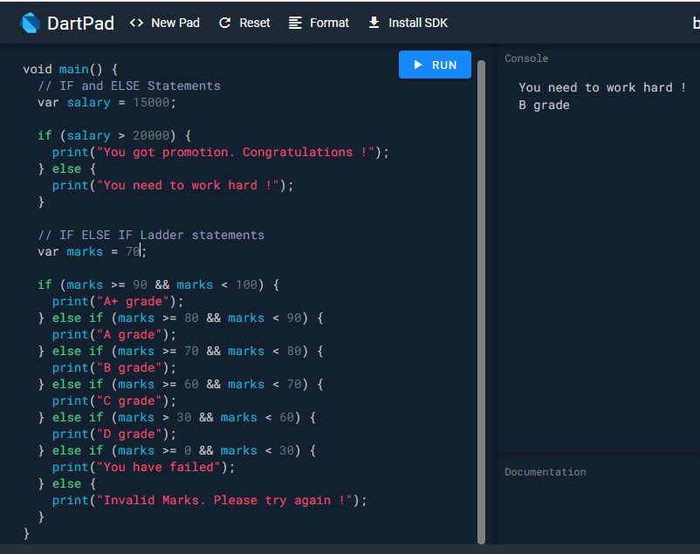
If-else example

Slide 15
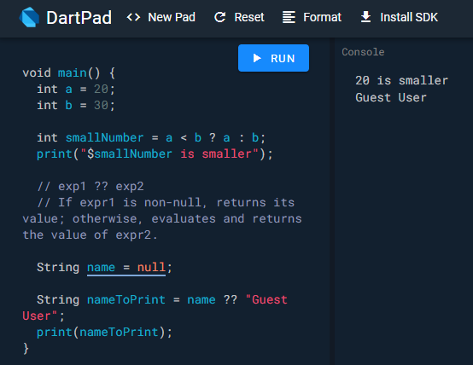
Conditional statements

Slide 16
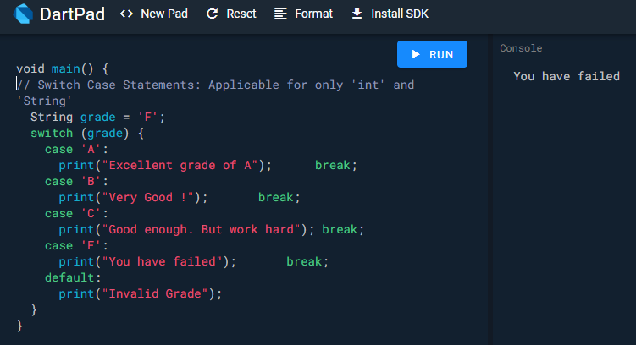
Switch

Slide 17
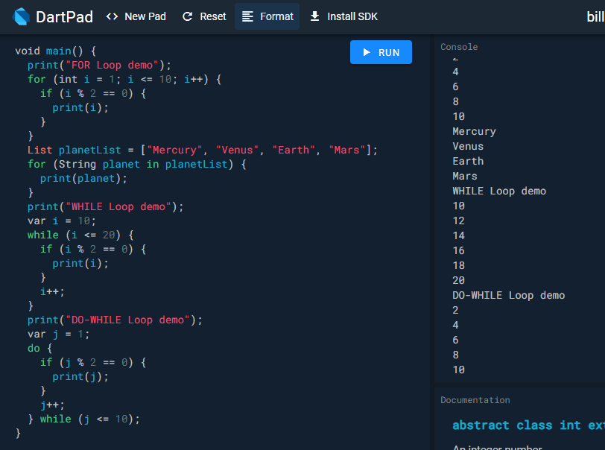
Looping

Slide 18
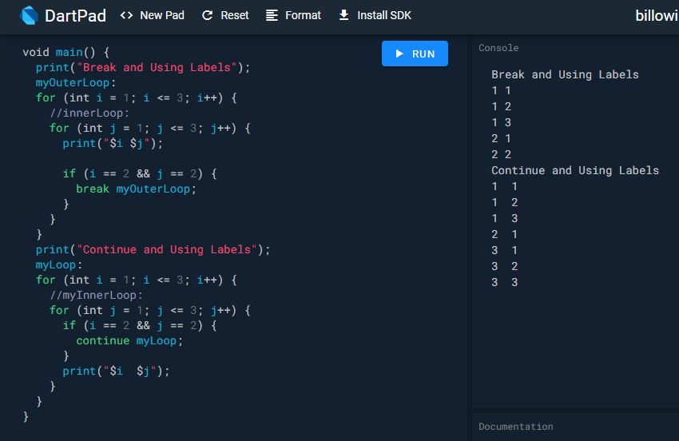
break and continue

Slide 19
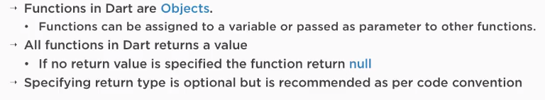
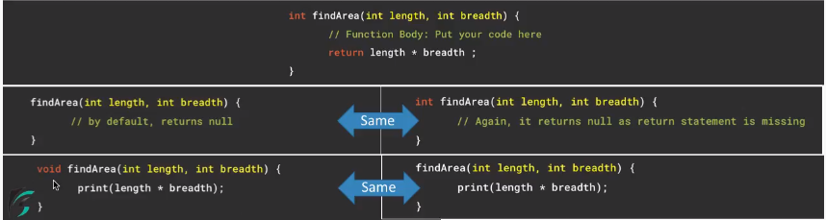
Functions and its properties

Slide 20
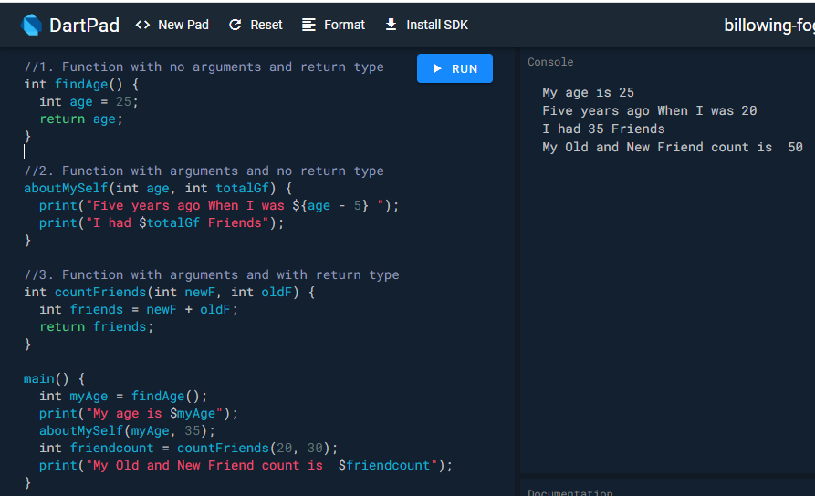
Functions

Slide 21
Shorthand Expression
Short manner to represent function
It is used when function returns single expression
Syntax -
return_type function_name(arguments) => expression;
A shorthand => (arrow) syntax is handy for functions that contain a single statement. This syntax is especially useful when passing anonymous functions as arguments:

Slide 22
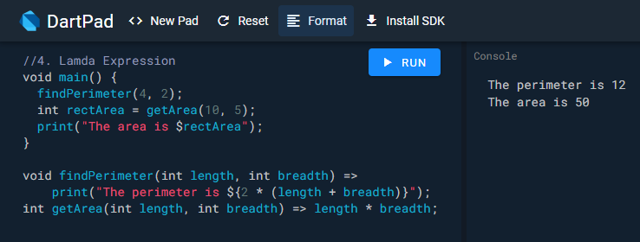
Shorthand Expression Example

Slide 23
Task to do
WAP which will take details of an Employee (eid , eage, ename, salary ).(take static values for now)
Use Shorthand exp in function for calculation of salary based on da :45% of salary
And Calculate Remaining years of service (retirement age 60 assume)
If age 25- 35 :ecategory ‘ Team Lead’
36-50:ecategory ‘Manager’
51-60:ecategory ‘ Executive ’
Use switch Case for below
If emp is team lead print ”Keep motivating your team ”
If emp is Manager print” Know all perspectives”
If emp is Executive print” Support your manager and team ”
Print All details of the employee

Slide 24
Expected output pattern
Employee Name: Leena Sahu
Employee Age : 31
Employee ID: KJSCE112
Years of service remaining:29
Employee basic salary: 25000
Employee total salary: calculated value
Employee Category: Team Lead ( based on age)
Message to Employee : Keep motivating your team
Employee Name: Leena1 Sahu1
Employee Age : 55
Employee ID: KJSCE20
Years of service remaining:6 calculated
Employee basic salary: 30000
Employee total salary: calculated value
Employee Category: Executive( based on age)
Message to Employee :Support your manager and team

